Slide 1
ES2 – AC3E Battery testing plan

Slide 2
Cell Choice
We are interested in testing wither 21700 or 18650 cells in both system and cell level

Slide 3
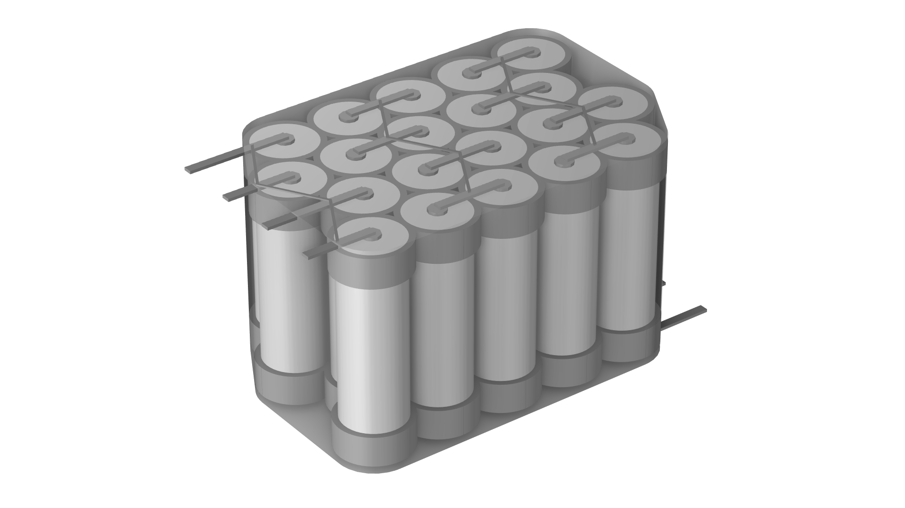
Model Geometry
Plastic Wrapping
Connectors
Terminals
20 cylindrical cells, type 21700
21 mm diameter
70 mm height
5s4p configuration (5 serial strings of 4 parallel cells)
Offset packaging
Plastic holder frames
Serial and parallel connectors
Thin plastic wrapping around the entire pack
Cell Holder
Cell malfunction after 1 min

Slide 4
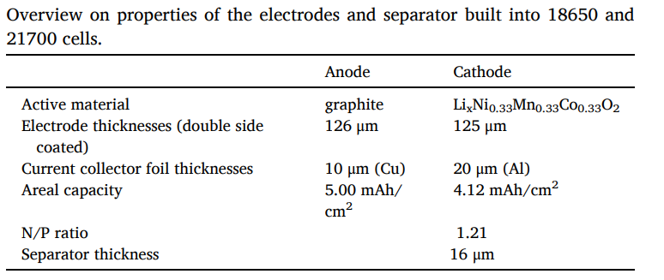
Cell details
The commercial NCM811-21700 cylindrical lithium-ion battery cell had a cathode containing approximately 80% nickel, 10% cobalt, and 10% manganese, with a diameter of 21 mm and a length of 70 mm

Slide 5
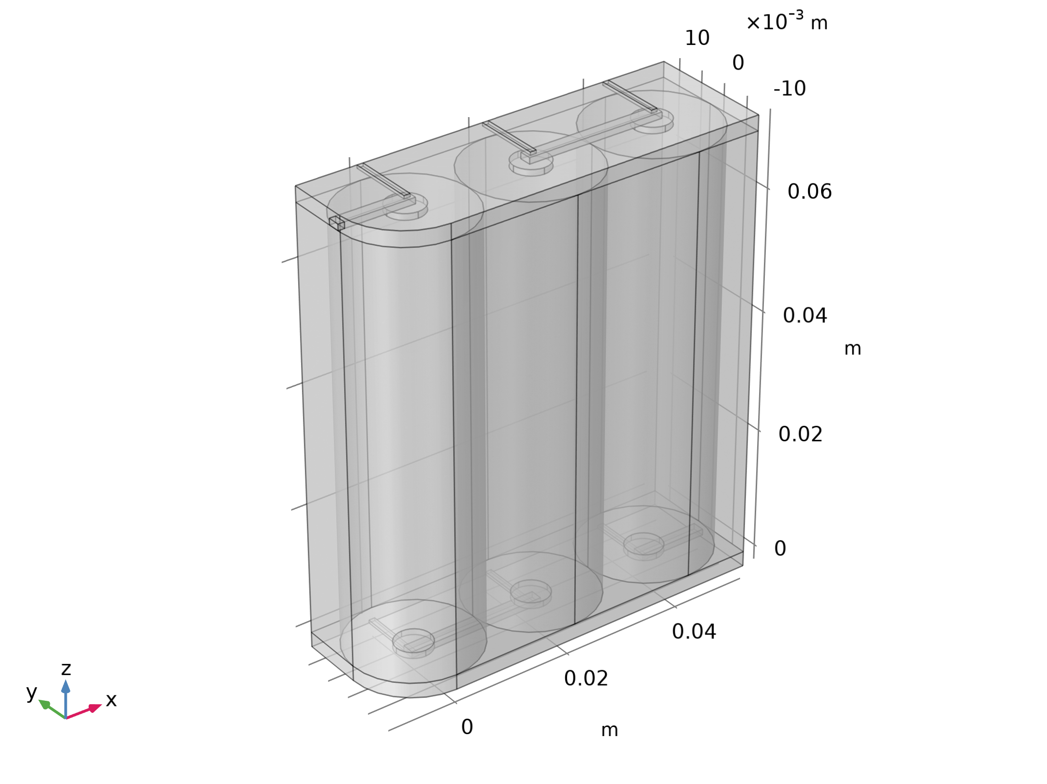
Model Definition
The figure shows the model geometry
Three 21,700 battery cylinders (21 mm in diameter, 70 mm high) are placed adjacent to each other
Small connecting strips of aluminum are located at the top and bottom of the cylinders according to the 6s2p configuration
The whole pack is assumed to be wrapped in plastic, forming a domain filled with air
Geometry 1

Slide 6
Model Definition
Assuming a nominal capacity of 4 Ah for each cell and nominal voltage of 3.7 V, the battery pack has a total nominal capacity of approximately 178 Wh
Geometry 1

Slide 7
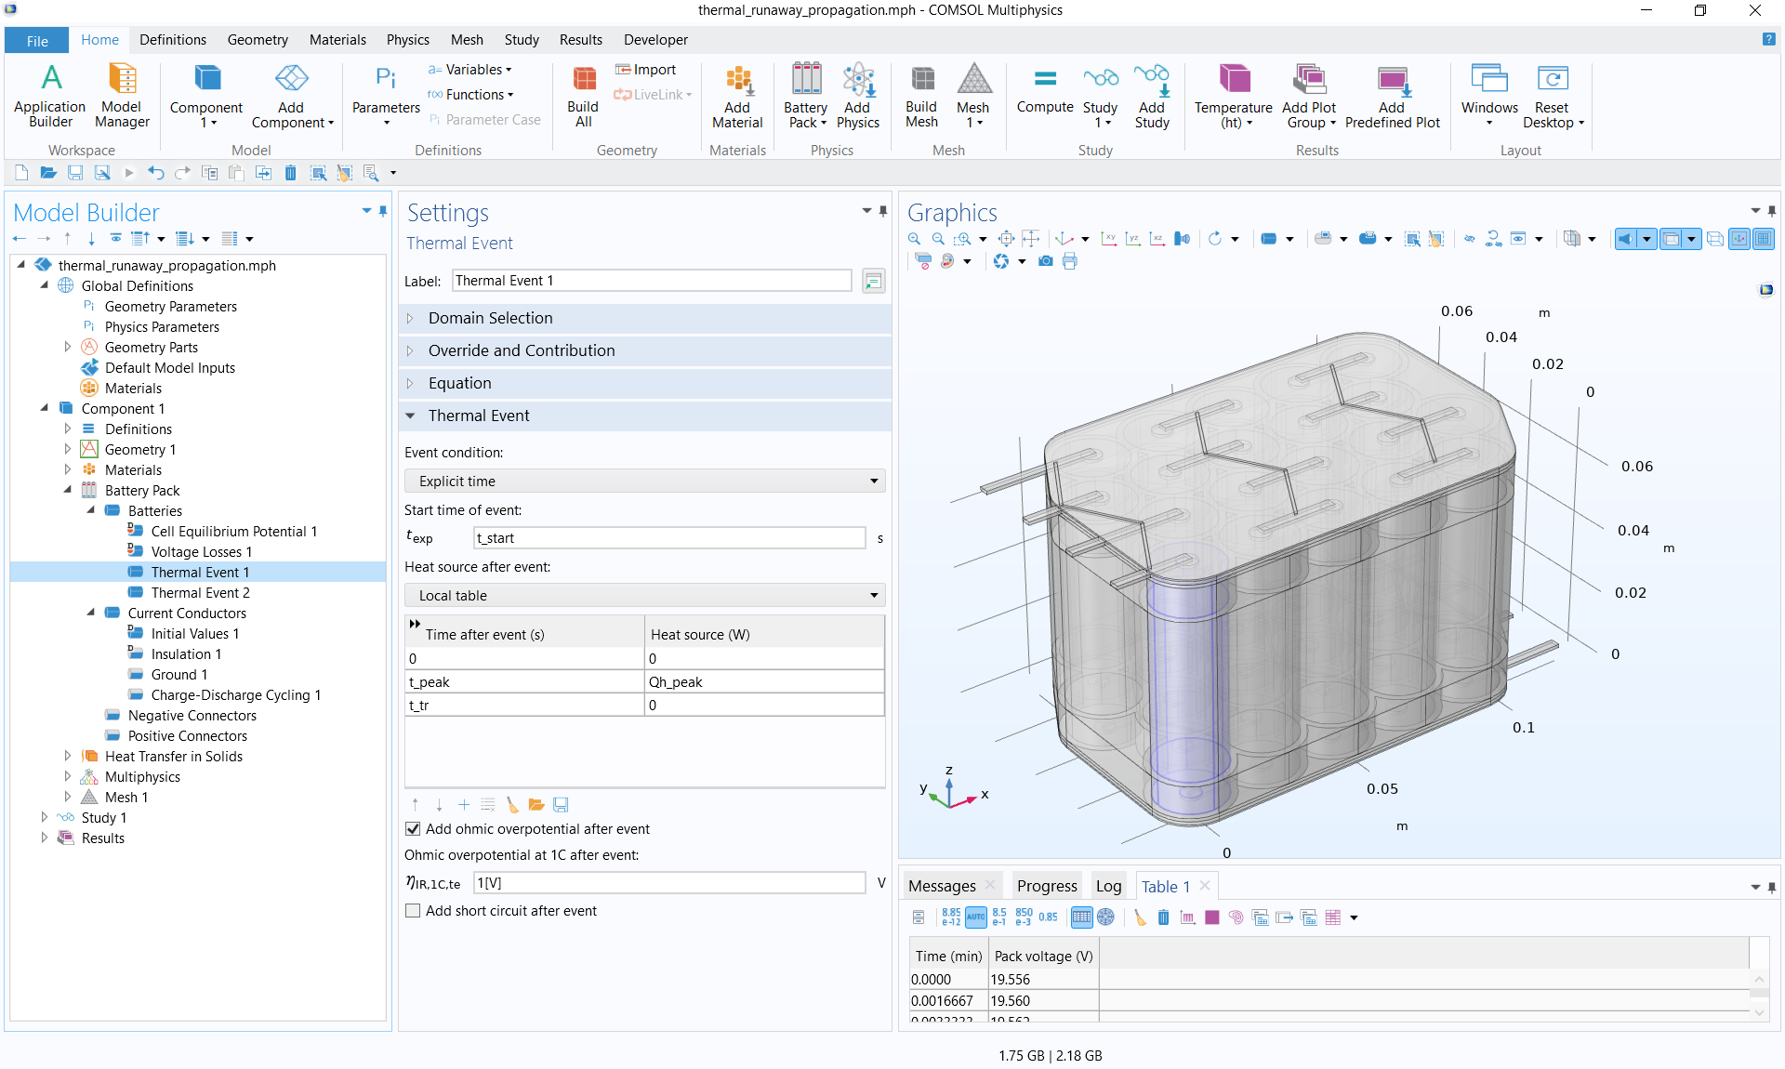
Model Setup
Battery Pack
Shared cell settings, defining one individual battery model in each cylinder
Current conduction in the connectors
Battery pack is charged at end terminals
2C current
Starting at 25% SOC with cutoff at 21 V
Thermal Event nodes
Explicit at 1 min for one cell
When temperature exceeds 80 °C for remaining cells
Ohmic resistances of batteries increased when events are triggered

Slide 8
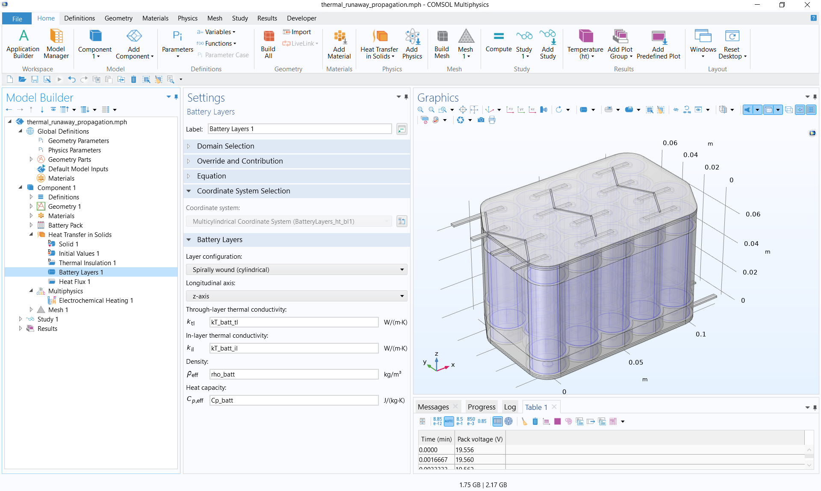
Model Setup
Heat Transfer
Anisotropic thermal conductivities in all cylinders define the jelly roll winding
Cooling by convection
Electrochemical Heating Multiphysics node
2-way coupling of heat sources and temperature
Heating due to
Joule heating in conductors
Electrochemistry inside cells
Thermal events

